Slide 1
Drug designer database
Carlos Dominguez(Developer, Tester, everything…) Product Owner: Dr. Luis Arroyo

Slide 2
Presentation
What’s my project about?

Slide 3
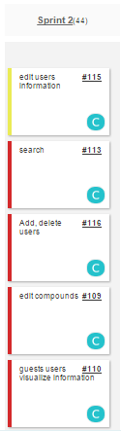
Stories in spring 2
Estimated
Actual
8 points
8 points
16 Points
16 points
16 Points
16 points
16 Points
0 points
8 Points
0 points
40 ---- = 1 40
Velocity =

Slide 4
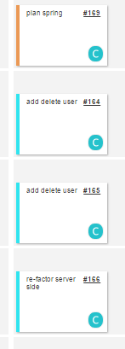
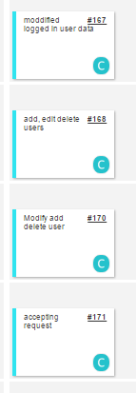
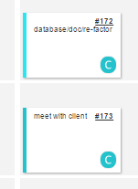
Mingle Daily Scrum

Slide 5
Documents
Feasibility Study & Project Plan: not need to changed
Requirement: not need to changed
Design: sequence diagram added
User Manual : features added
Installation and maintenance: not changed

Slide 6
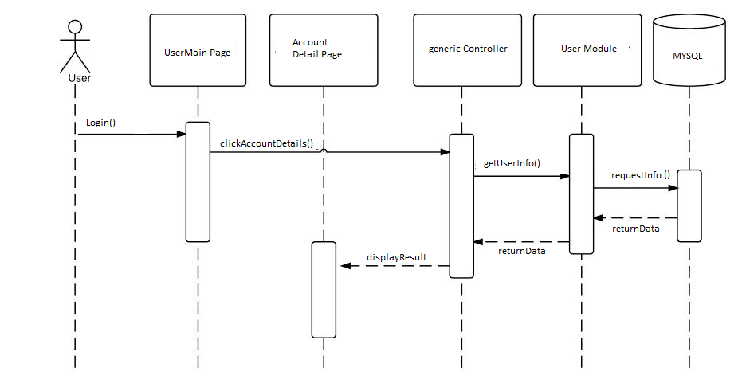
Show User Info sequence Diagram

Slide 7
User Manual
Login feature explained for admins.
Add delete logged in user feature explained
Add, delete, modify users for admins explained.

Slide 8
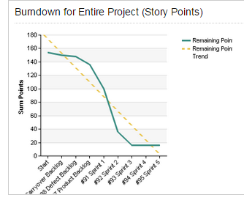
BurnDown Chart
All story points were finished

Slide 9
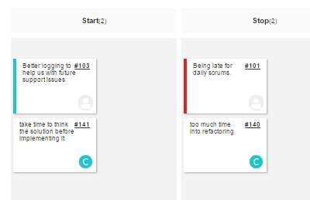
Retrospectives
Start:
need to write in words what I am going to do before doing it
Stop
need to spend less time into re-factoring and more time into coding other features

Slide 10
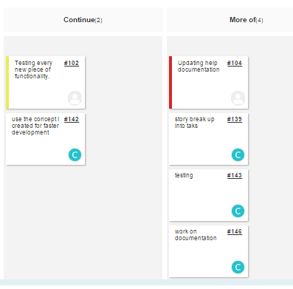
Retrospective
Continue
need to continue using the concept where there is a universal controller and add on on to it This serves for organization and structural purposes
More of
- breaking the story points into smaller tasks
- testing
Documentation

Slide 11
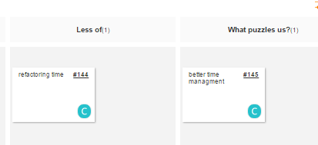
Retrospective
Less of: time in refactoring
What puzzles us? need to implement better time stimation

Slide 12
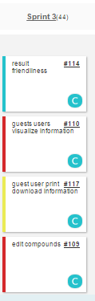
Current Sprint

Slide 13
DEMO

